Slide 1
Diagnostic Lab Reporting System
Presented by:
Md. Sohanur Rahman UG02-40-15-12 Md. Abdullah Al galib UG02-40-15-029

Slide 2
Introduction
Diagnostic Lab Reporting System is a web application which will helps a patient to book diagnostic tests online. After completing tests, the downloadable report will available in his/her profile. Users can choose a diagnostic center according to their budget and requirements. Diagnostic admin and staffs will manage all the order processing steps using their custom dashboards.

Slide 3
Purpose
Purpose of this project is to provide a simple, easy, convenient and efficient system to manage the diagnostic test booking and lab reporting process. This System helps individuals to book their test online.
A diagnostic admin can create, edit, delete tests and categories. Diagnostic staffs can approve, reject, verify, confirm, and complete order operation. Customers can able to view and download their reports from the profile and also can re-payment if the payment type was the half.
Using this software, a particular diagnostic center can manage their lab test booking and reports in a very efficient and effective way. Aim of this software is to build an easy diagnostic test booking process for the customers using the internet.

Slide 4
Scope
Interactive and user friendly UI helps every type of users to interact with the interface.
This application is designed following MVT (model-view-template) architecture.
Any task within the application happens in real-time as all data is stored and maintained from the built-in database named SQLite3.

Slide 5
Objectives
This system is designed for 4 types of user roles in the system:
System Admin.
Diagnostic Admin
Diagnostic Staff
Customer.
A system admin can able to manage diagnostic centers including admins, staffs, customers and all other functionality of the application.
Customers have to sign up for the first time.
A logged-in user can place a new order including all the necessary information and view order, report status and update their profile information as well.
Diagnostic staffs can approve, reject, verify, confirm, and complete order operation.
Diagnostic admin can create, edit, delete tests, categories and able to manage diagnostic center including staff operations.

Slide 6
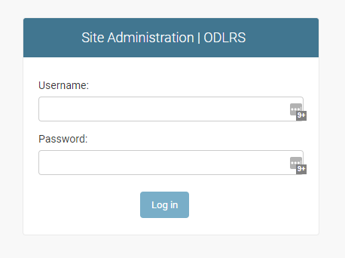
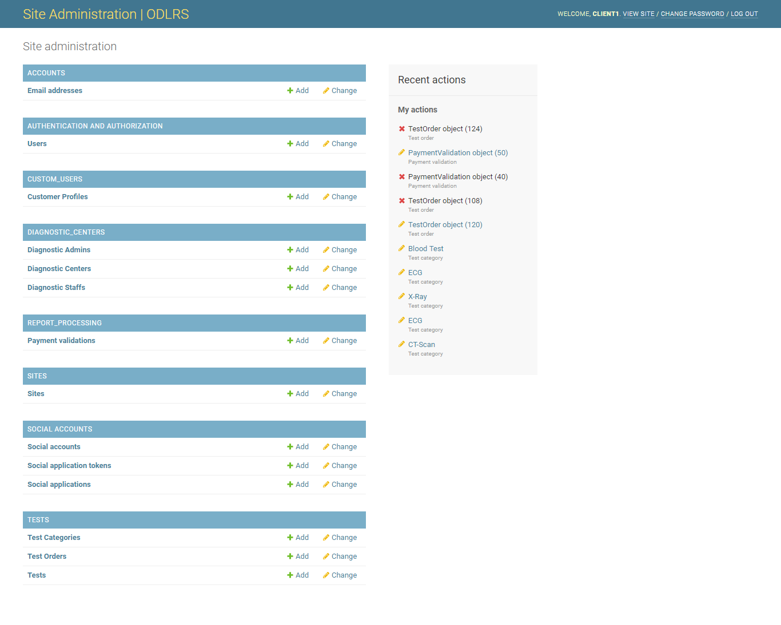
User Interface (System Admin)

Slide 7
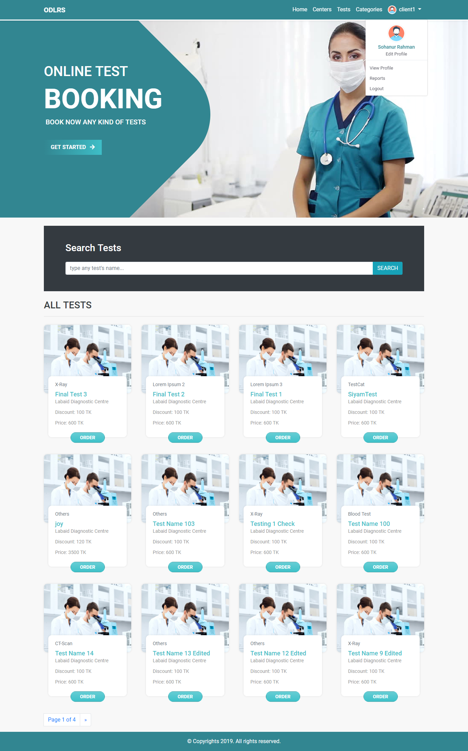
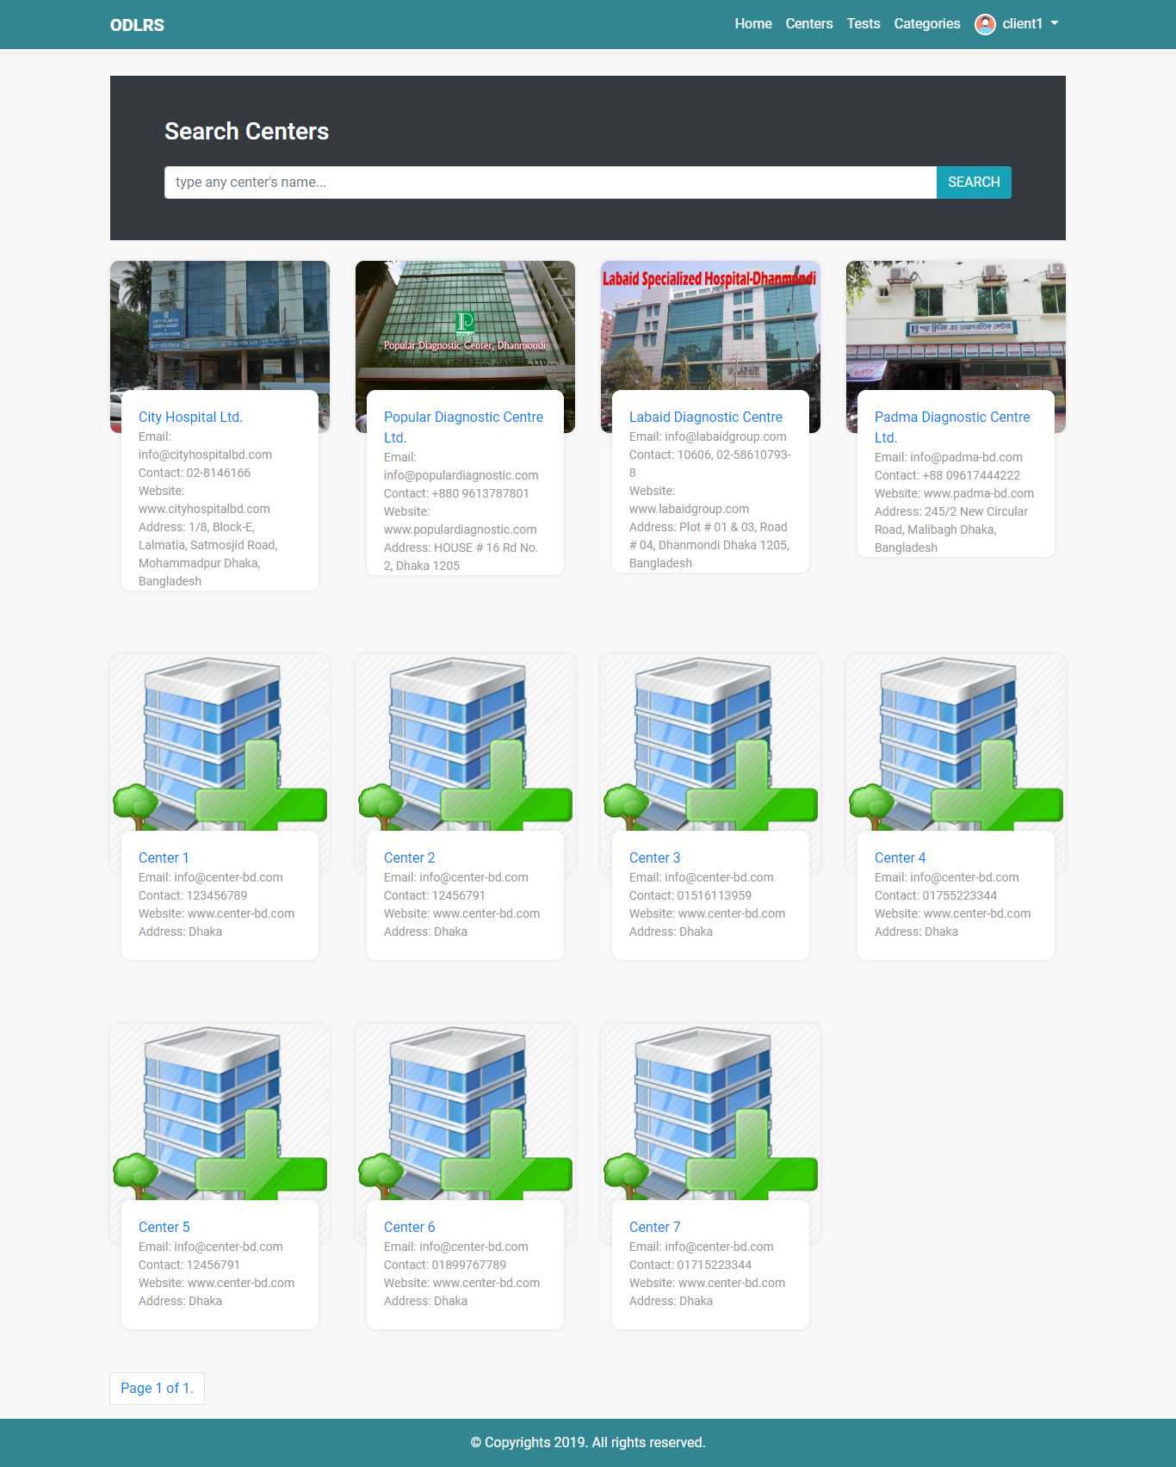
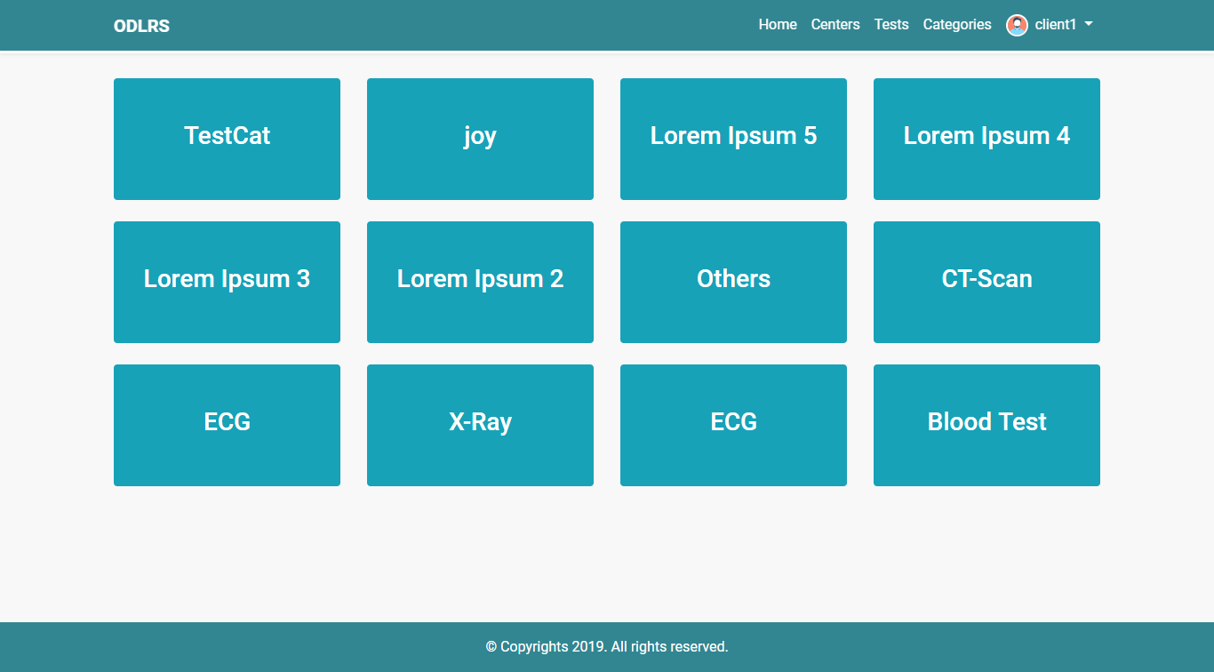
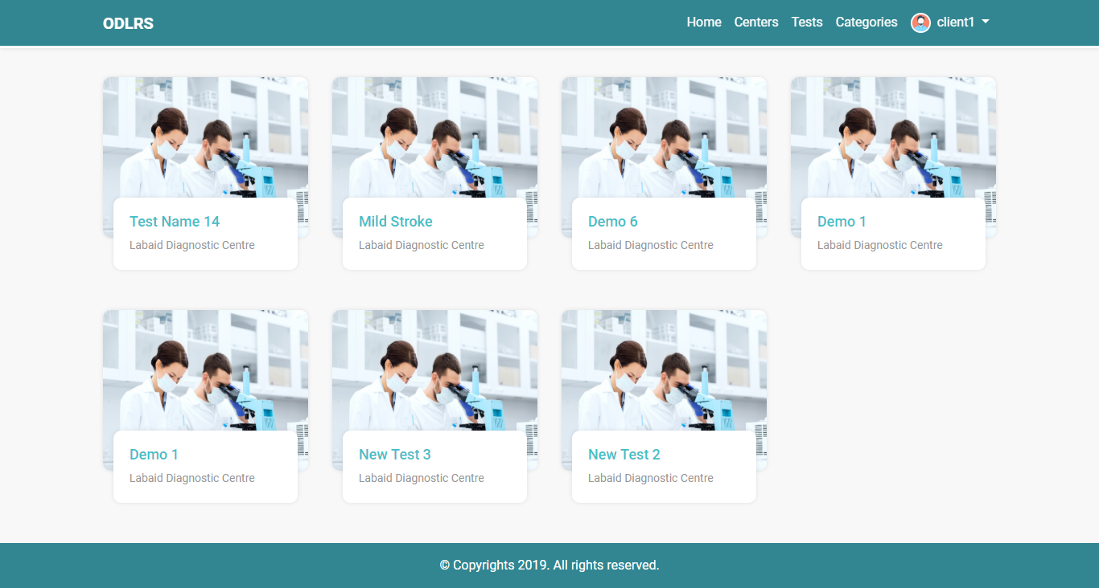
User Interface (Home)

Slide 8
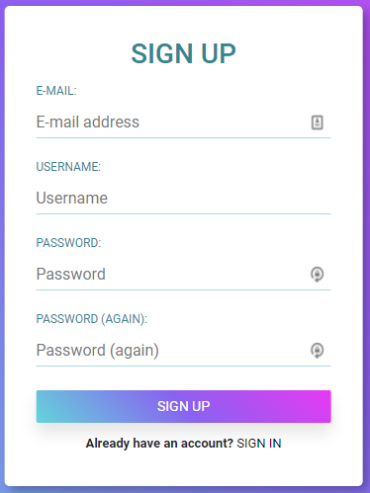
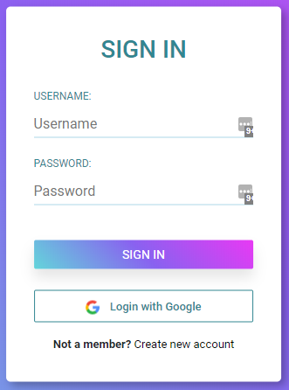
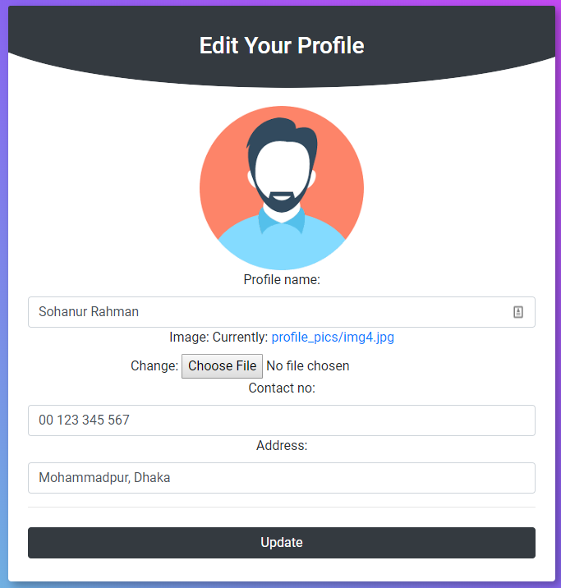
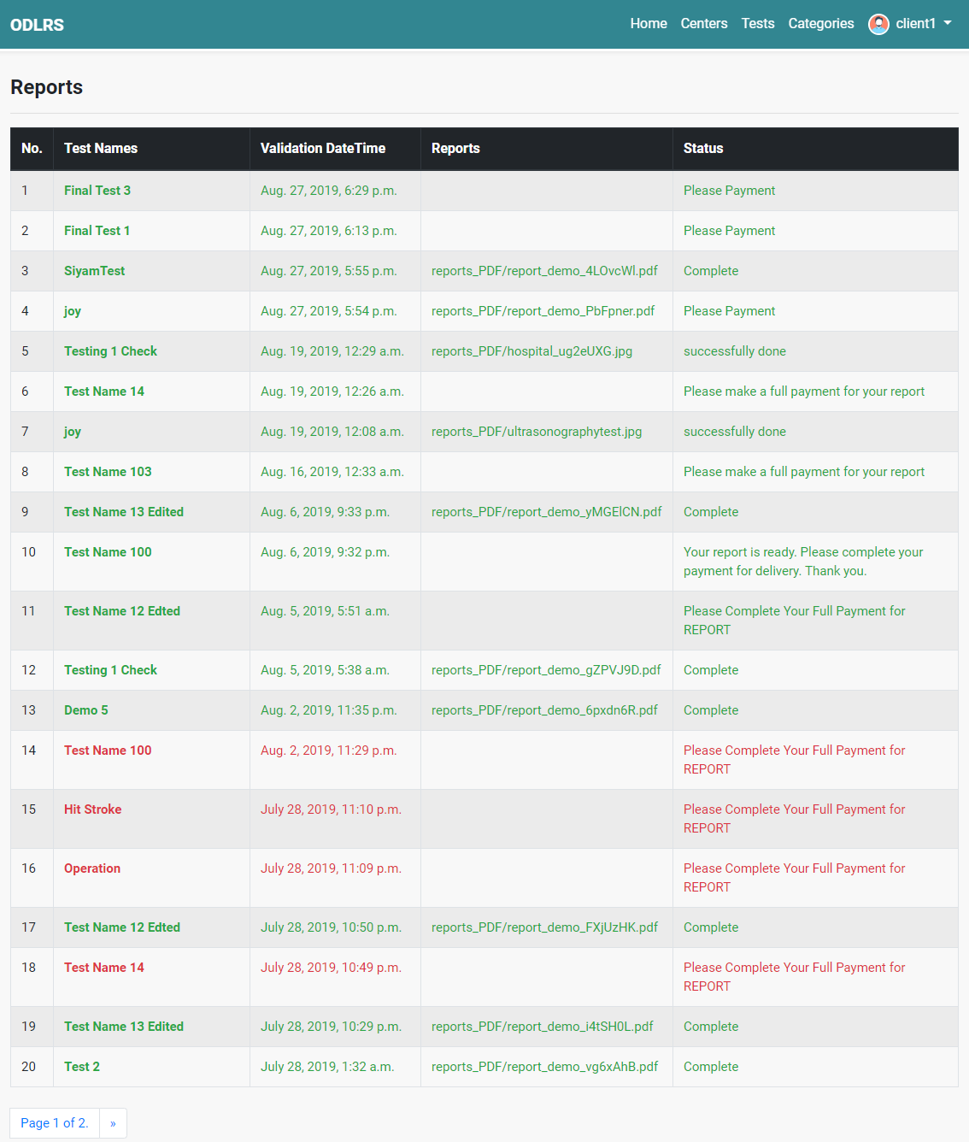
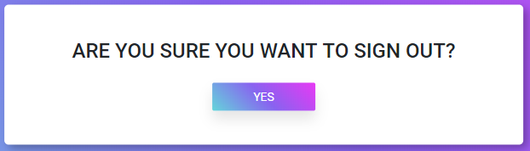
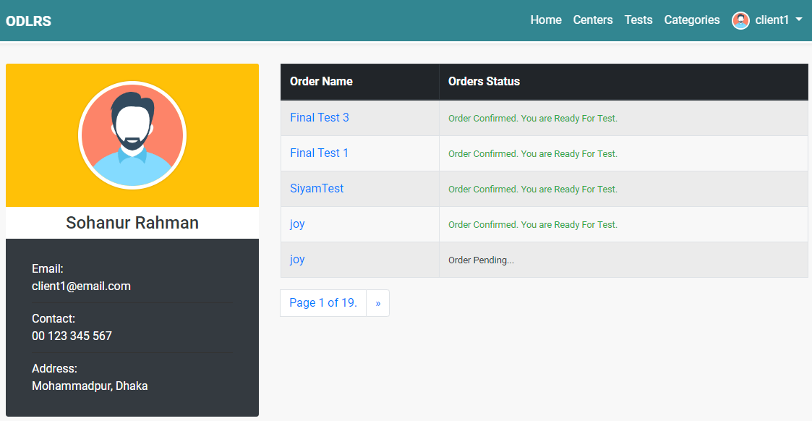
User Interface (Customer)

Slide 9
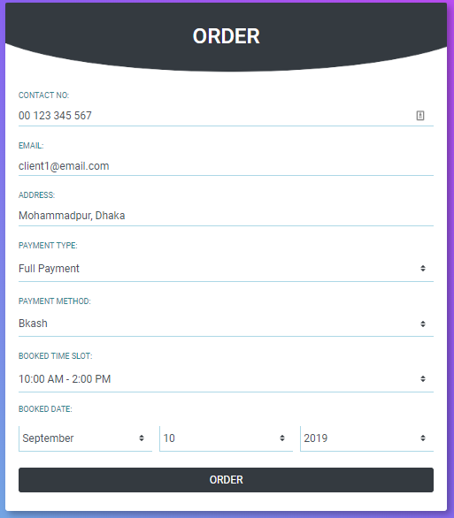
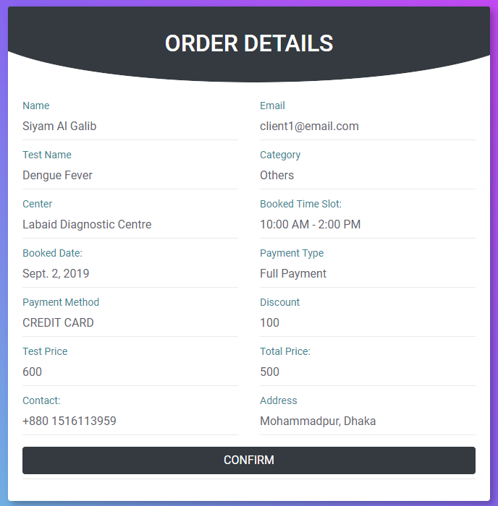
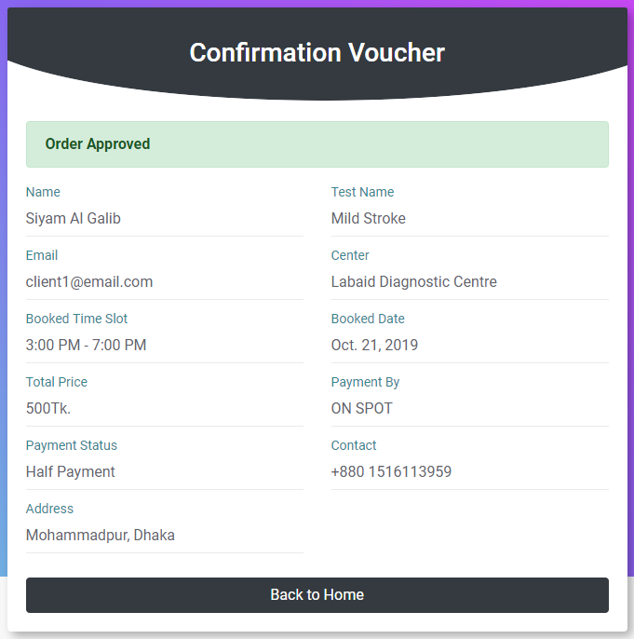
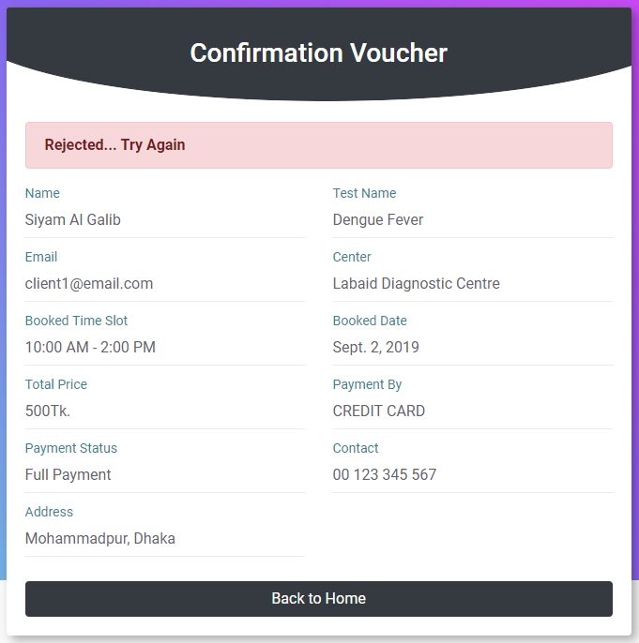
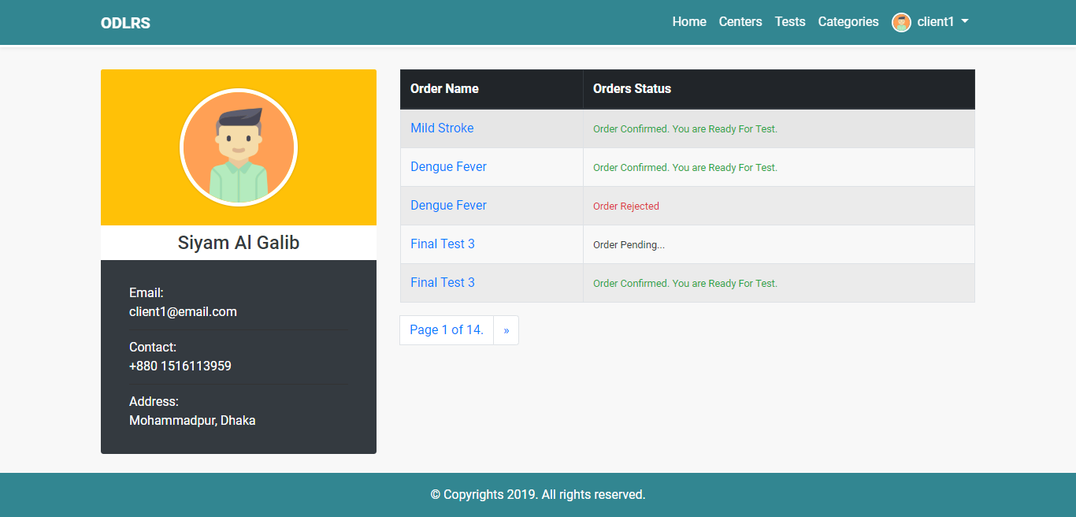
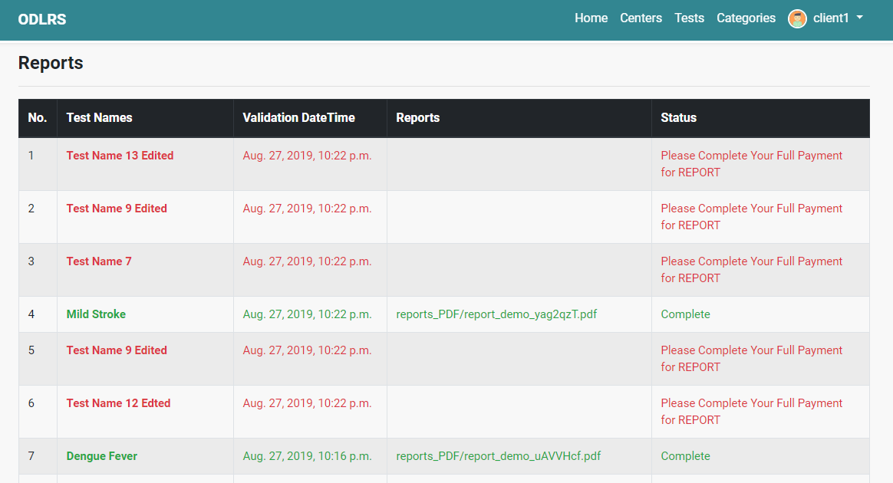
User Interface (Order) Part 1

Slide 10
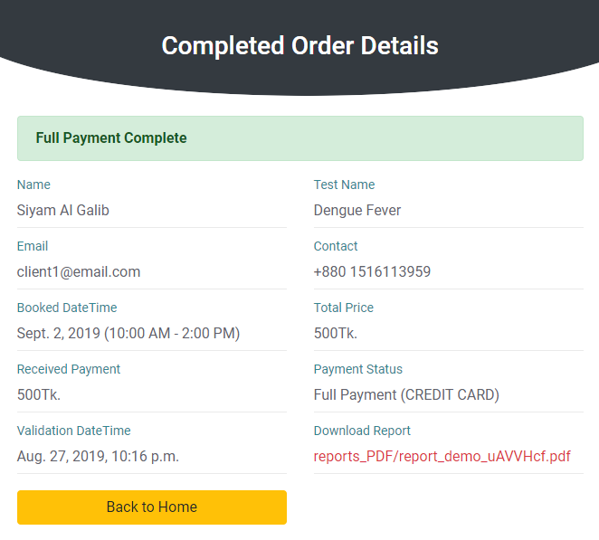
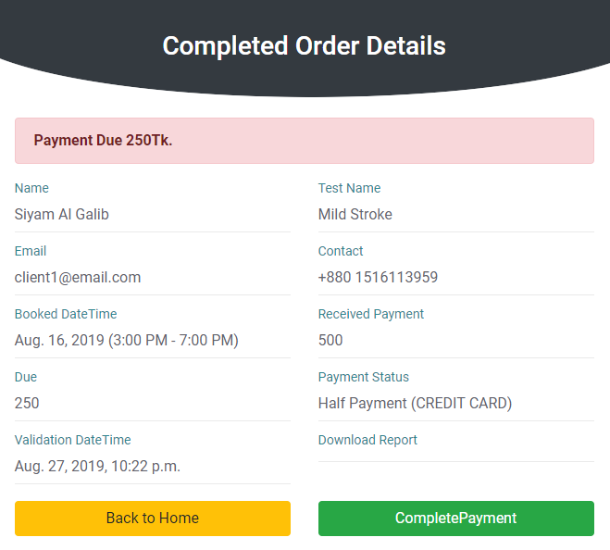
User Interface (Order) Part 2

Slide 11
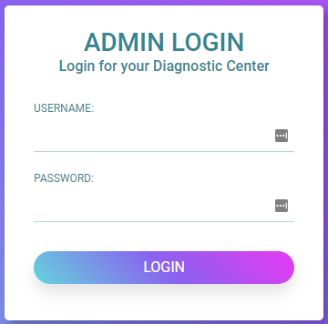
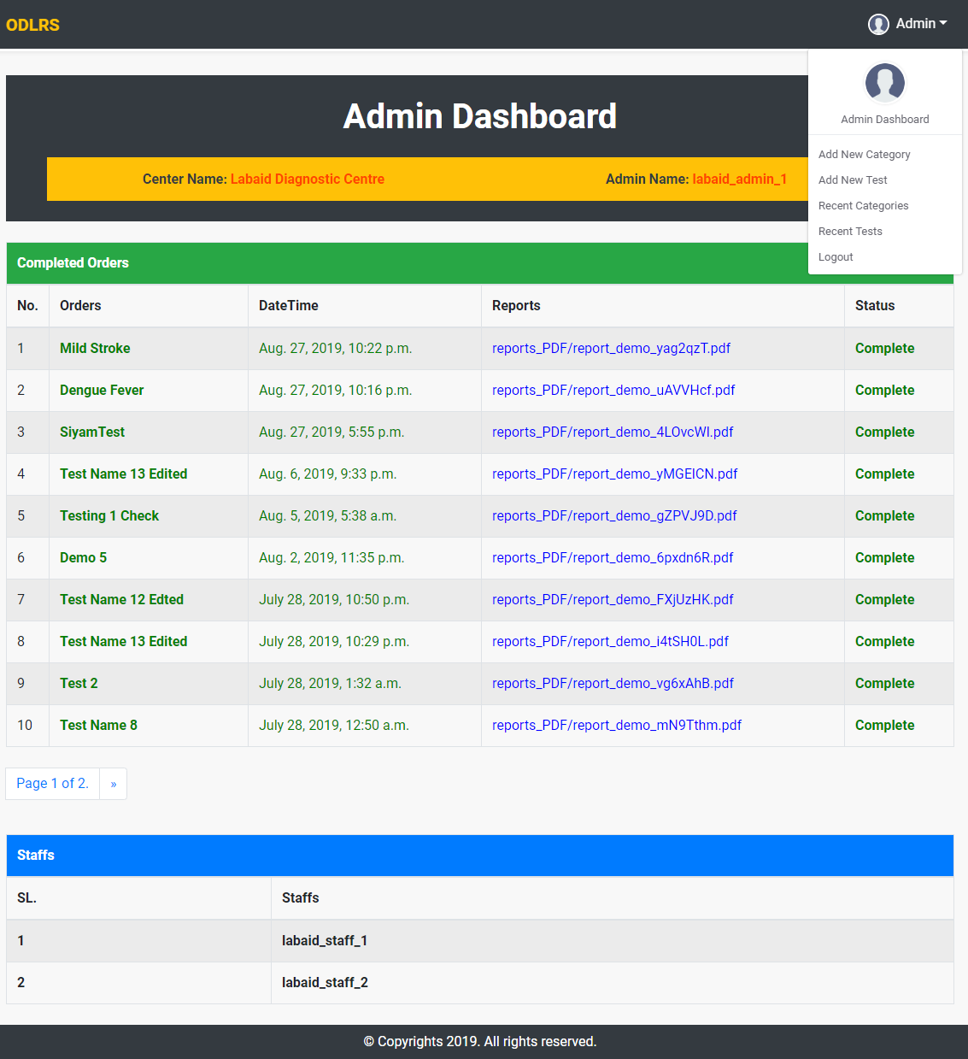
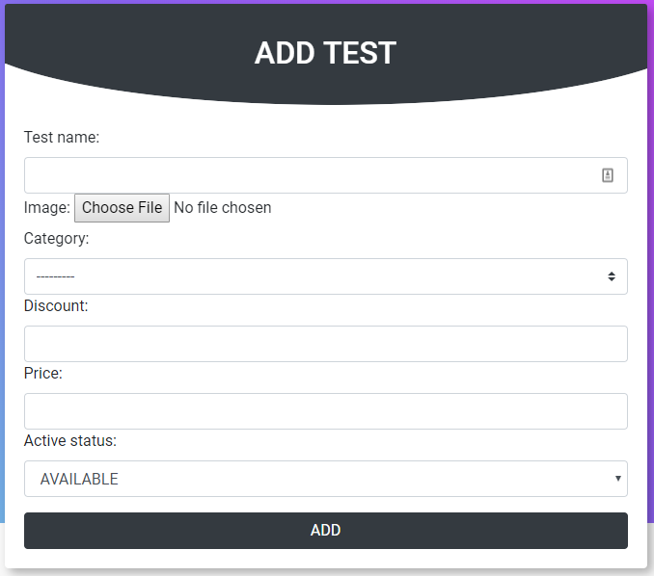
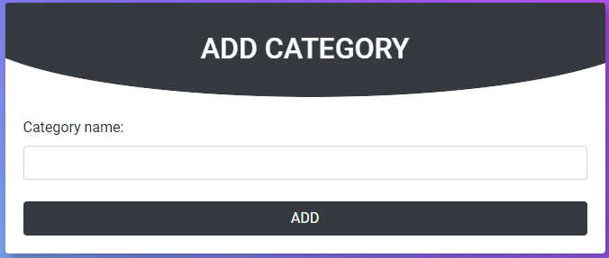
User Interface (Diagnostic Admin) Part 1

Slide 12
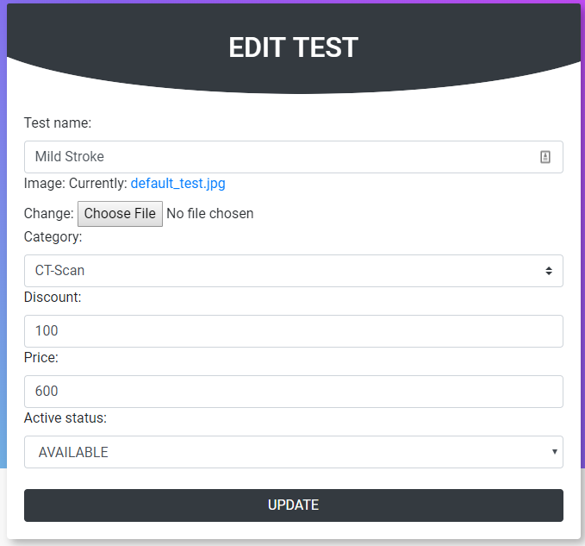
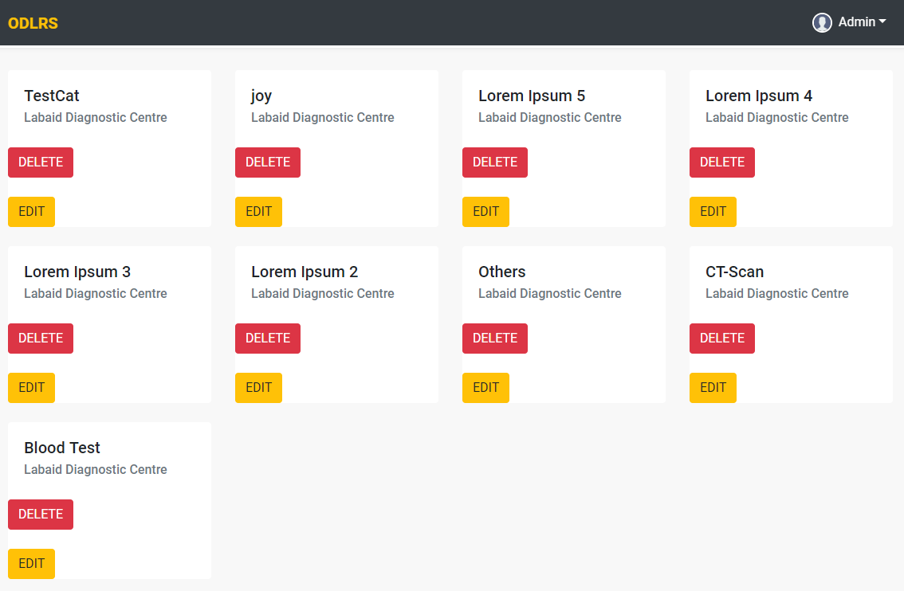
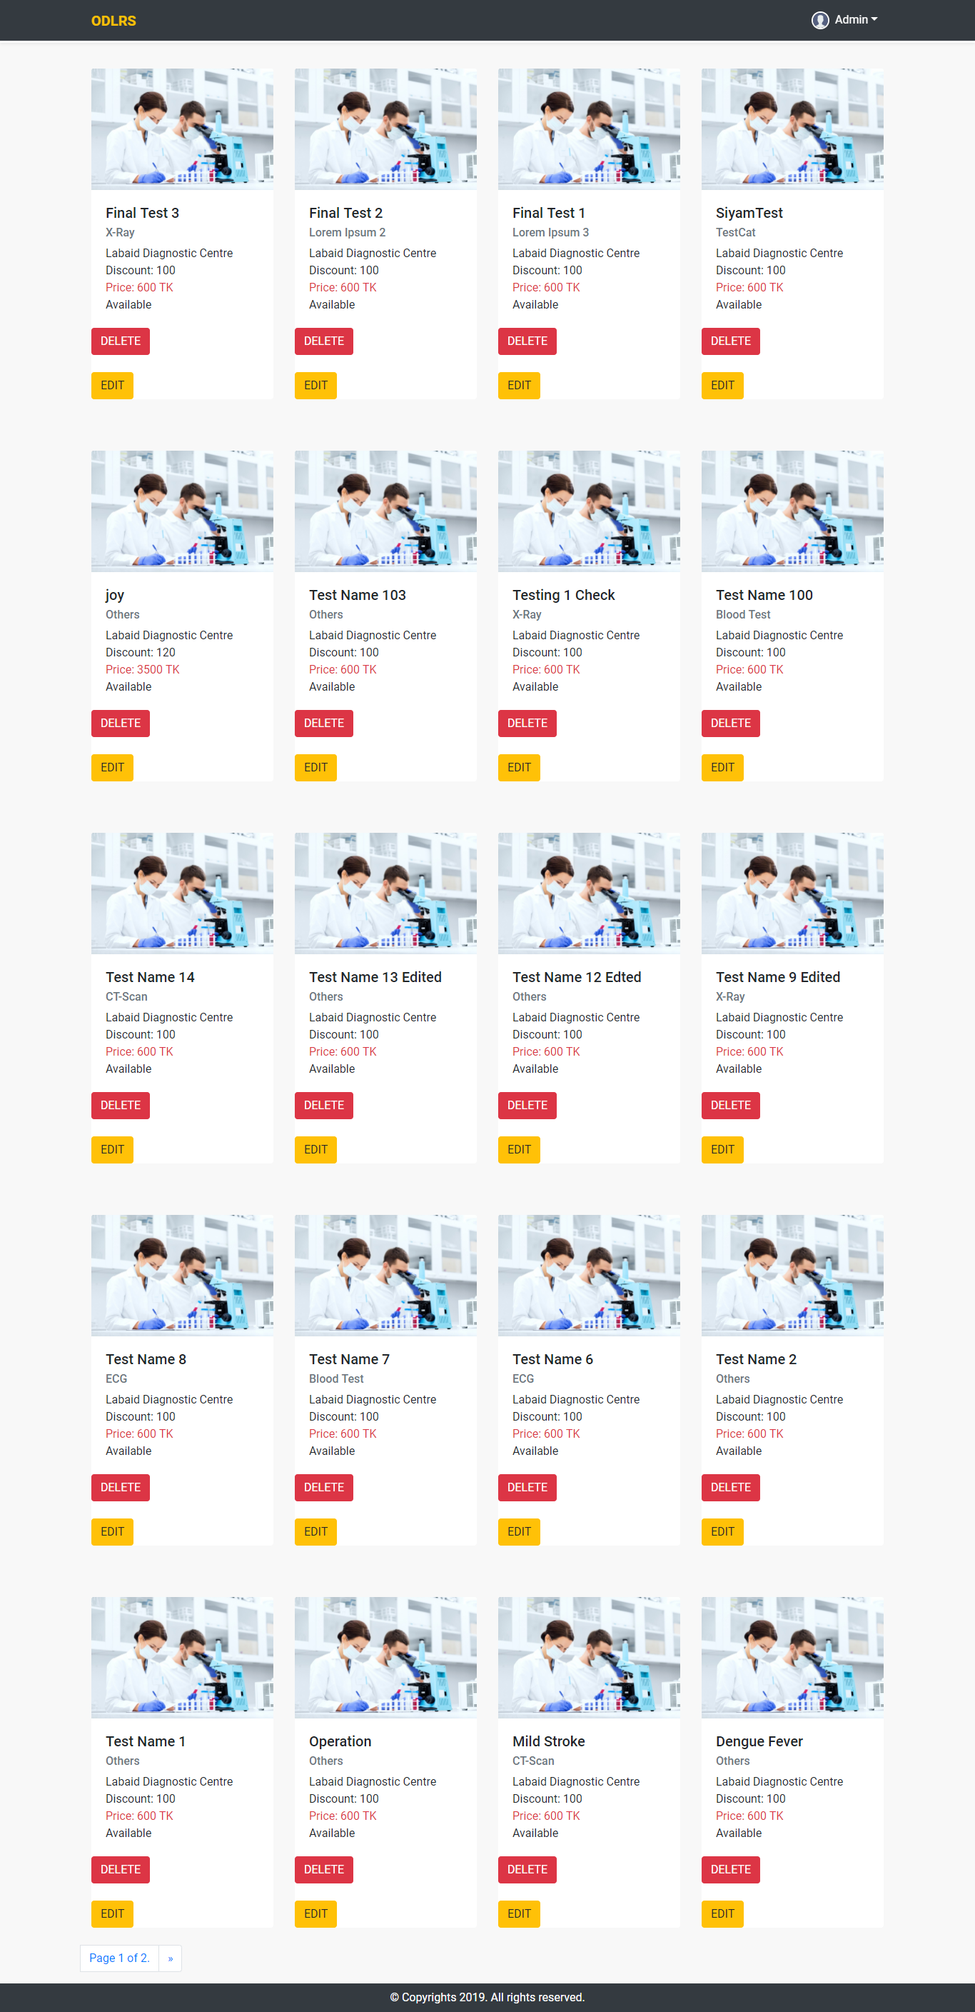
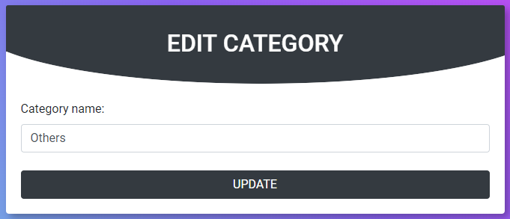
User Interface (Diagnostic Admin) Part 2

Slide 13
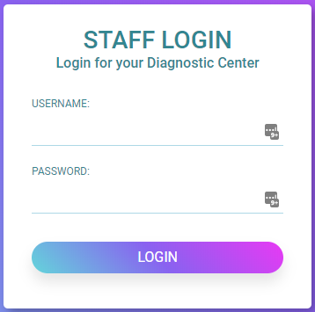
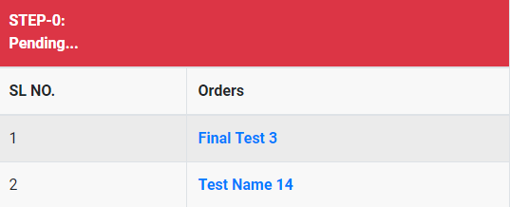
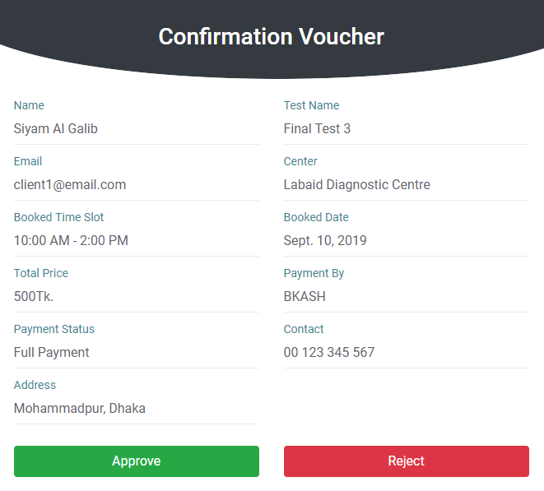
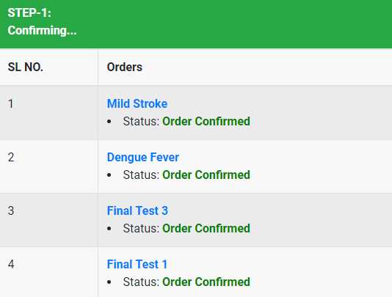
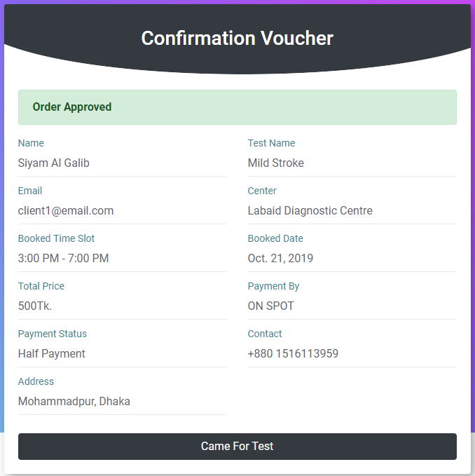
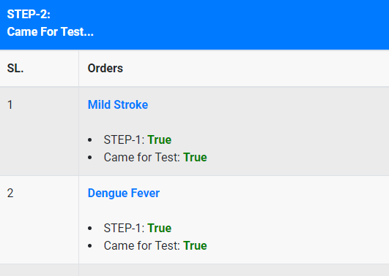
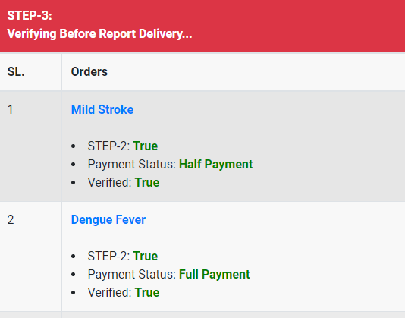
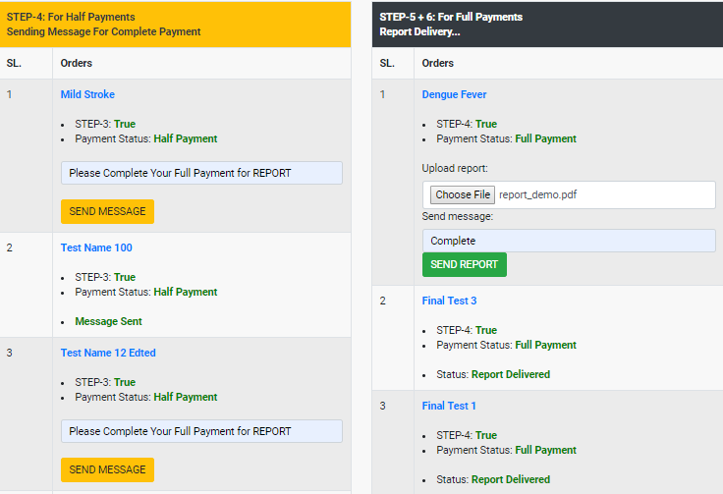
User Interface (Diagnostic Staff) Part 1

Slide 14
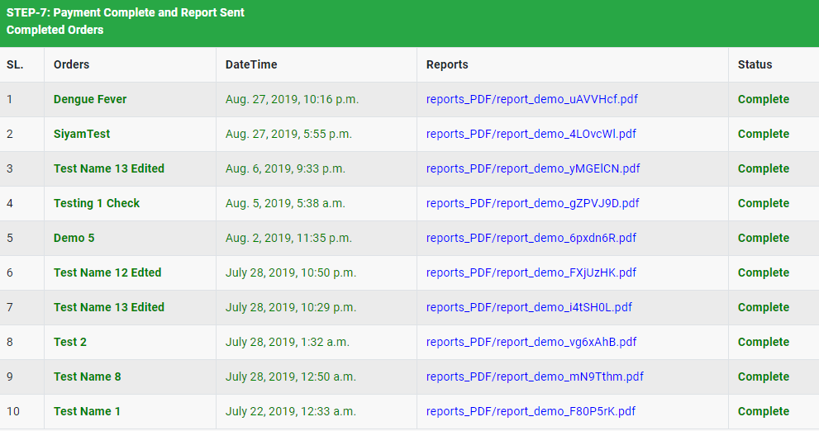
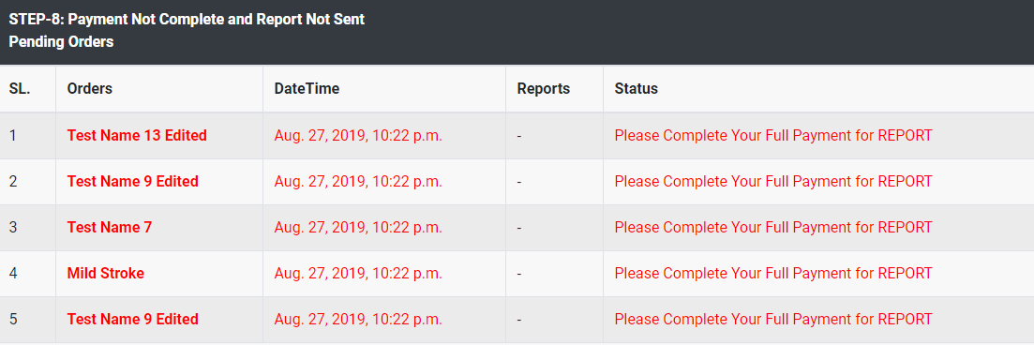
User Interface (Diagnostic Staff) Part 2

Slide 15
Tools and Technologies
Python 3
Django 2.2 Lts
SQLite 3
HTML 5
CSS 3
Bootstrap 4
JavaScript
Git/GitHub
Virtual Environnent
Adobe Photoshop CC 2018, Adobe XD
PyCharm Professional, Visual Studio Code (IDE)

Slide 16
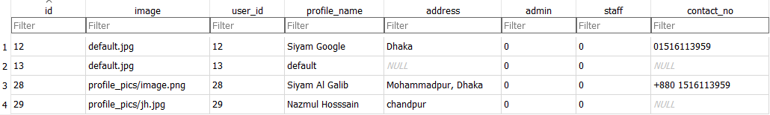
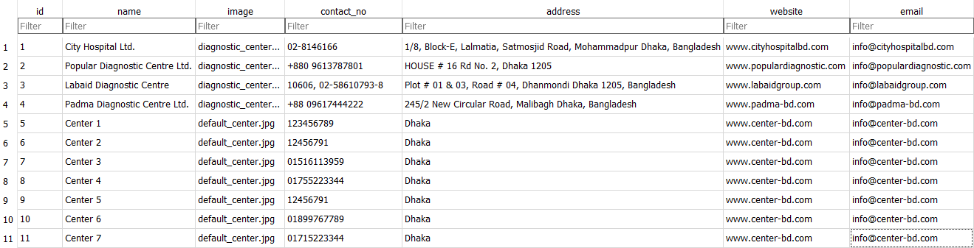
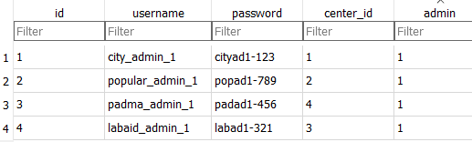
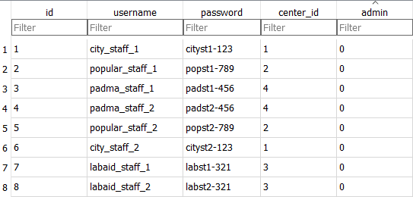
Database Structure Part 1

Slide 17
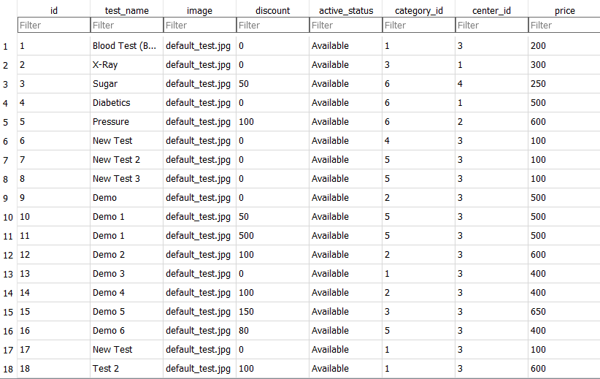
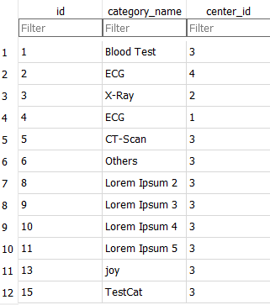
Database Structure Part 2

Slide 18
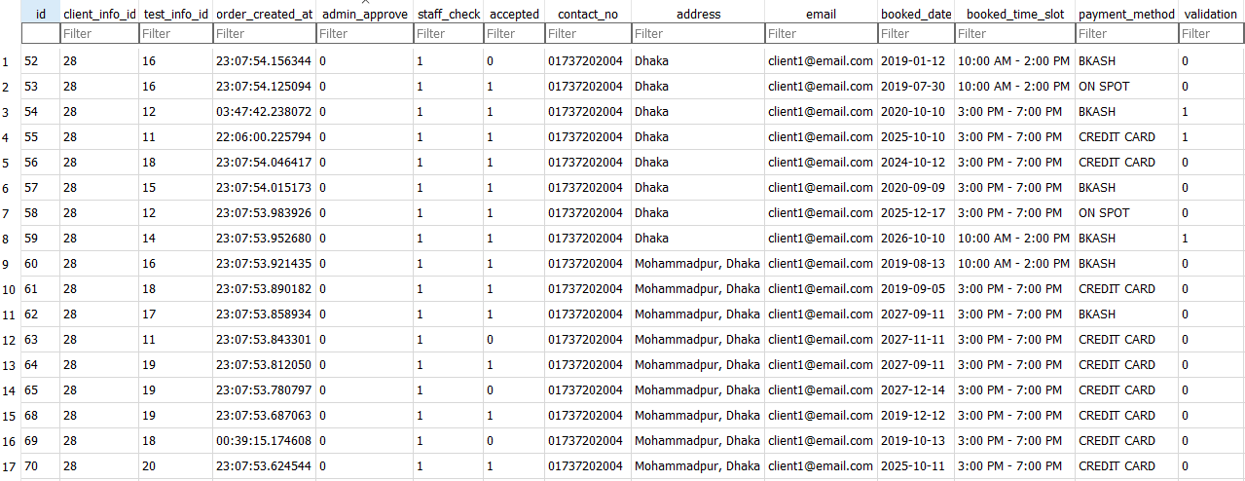
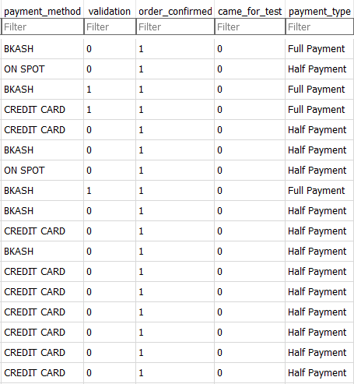
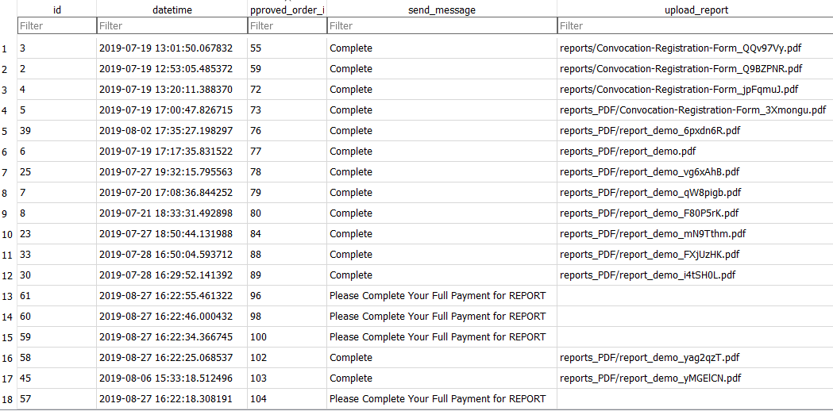
Database Structure Part 3

Slide 19
Future Work
We tried to give our best to achieve all goals from this application but still, we need a lot of improvements. In future there could be several improvements done and adding some feature will make this app more usable and widen. List of some features and improvements are given below:
Push Notifications.
Payment Gateways.
Advance Search Option.
Cart system for multiple orders.

Slide 20
Thank you.
Let us know if you have any questions!

